Slide 1
Heat Injury & Illness
Virginia Department of Labor & Industry
Sarah Smith, Consultation Program Manager

Slide 2
Heat Illness Campaign
Addresses heat-related illness and injuries resulting from body heat generated by physical work that is performed in conditions of high ambient and/or radiant heat
to educate employers and workers on heat injury and illness prevention in outdoor and indoor work settings, and
the importance of “Water. Rest. Shade.”
Notes:
Launched in 2011 educates employers and workers on the dangers of working in the heat. and to stress the importance e of water, rest and shade. t targets indoor and outdoor activity. The Campaign ramps up during hot months, however it is a yearlong campaign.

Slide 3
Heat Illness and Injury Statistics
From 1999 to October 2021, a total of 17 heat-related employee fatalities and 5 employee hospitalizations were reported to VOSH
50-70 % of work-related injuries happen within the first few days of working in warm or hot environments
Almost half of heat-related deaths occur on a worker’s very first day on the job (Arbury 2014).
Over 70 percent of heat-related deaths occur during a worker’s first week (Tustin 2018)
Heat related fatalities have occurred with a heat index below 80°F
Heat was a contributing factor in 1,577 U.S. deaths in 2021, according to provisional data.
Forcing people to work in deadly heat is mostly legal in the U.S
Most workers are responsible for preventing on-the-job heat injuries
Notes:
This is a list of heat related statistics that impact Americas workforce. Forcing people to work in deadly heat is mostly legal in the U.S

Slide 4
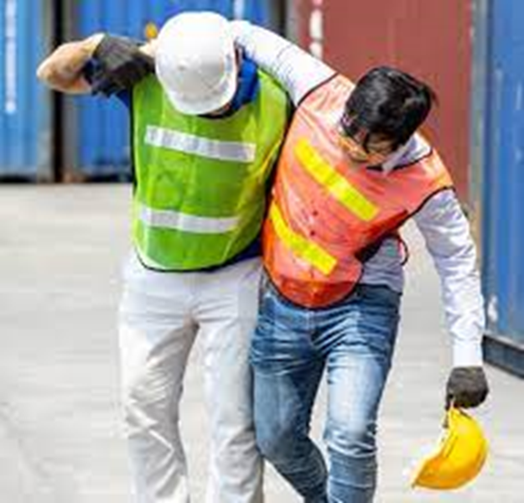
National Emphasis Programs (NEPs) are temporary programs that focus OSHA's resources on particular hazards and high-hazard industries. Existing and potential new emphasis programs are evaluated using inspection data, injury and illness data.
The goal of this NEP is to reduce or eliminate worker exposures to heat-related hazards that result in illnesses, injuries, and deaths, by targeting industries and worksites, including worksites with radiant heat sources, where employees are exposed to heat related hazards and have not been provided adequate protection that includes cool water, rest, cool areas, training, and acclimatization.
NEP-Outdoor and Indoor Heat –Related Hazards
Notes:
While we don’t have a heat standard we have an NEP. Effective April 2022 OSHA introduced a indoor/outdoor heat NEP. The goal of this NEP is to reduce or eliminate worker exposures to heat-related hazards that result in illnesses, injuries, and deaths, The NEP greenlights OSHA to conduct heat-related inspections on high-risk worksites while encouraging protective measures such as training, acclimatization procedures, and access to water, rest and shade.

Slide 5
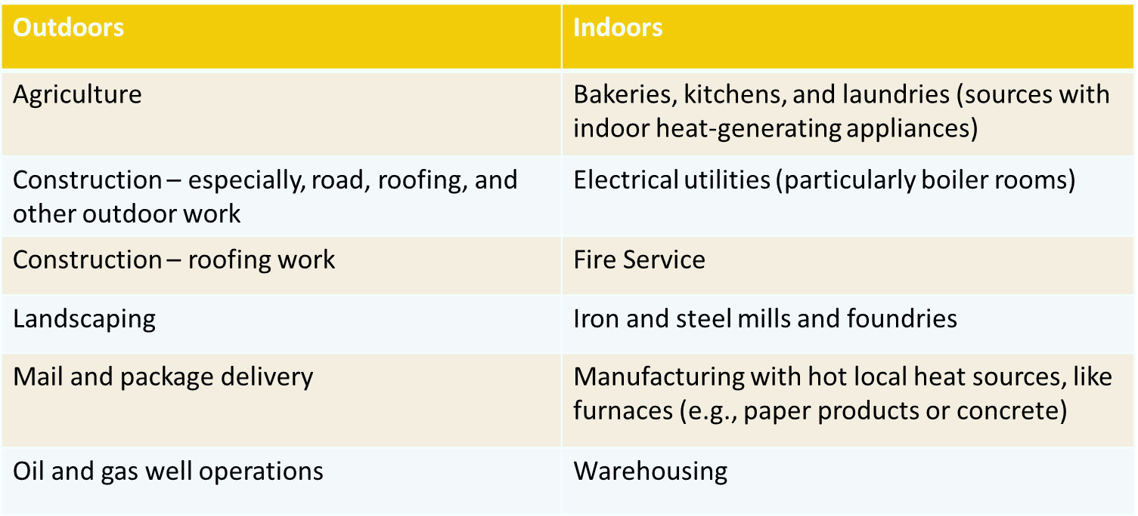
Hazardous heat exposure can occur indoors or outdoors and can occur during any season if the conditions are right, not only during heat waves. The following is a list of some industries where workers have suffered heat-related illnesses.

Slide 6
Appendix A: Target Industries for the Heat NEP
2017 4-Digit NAICS Code | 2017 NAICS Industry Sector Title
2382-- | Building Equipment Contractors
Table 2: Construction industries that are likely to have heat-related hazards
Electrical contractors -NAICS 238210
Notes:
App a is a list of NEP target industries that are likely to have heat related hazards

Slide 7
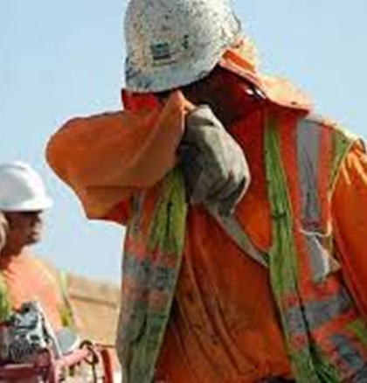
Heat Related Illness
What is a heat-related illness?
In a warm environment, especially when physically active, the human body relies on its ability to get rid of excess heat (i.e., heat dissipation) to maintain a healthy internal body temperature. If heat dissipation does not happen quickly enough, the internal body temperature keeps rising and the worker may experience a heat illness.
There are multiple heat related illnesses that can affect workers. Some of the symptoms are non-specific. This means that when a worker is performing physical labor in a warm environment, any unusual symptom can be a sign of overheating.
Notes:
Its an illness that is sustained when an overheated body cant dissipate excess heat, physical activity is usually a contributing factor.

Slide 8
Heat Illnesses
Heat Stroke
Heat Exhaustion
Heat Rash
Heat Cramps
Heat Syncope
Rhabdomyolysis( muscle breakdown)
AKI ( acute kidney injury)

Slide 9
Employer Responsibilities
Heat Illness Prevention Plan( HIPP)
Notes:
Employers have a responsibility to protect their employees who work in hot environments with sustained temperatures. Additionally provide measures to ensure that employees are protected. Implementing a heat illness prevention plan is key.

Slide 10
Heat Illness Prevention Program (HIPP)
Employers should develop and implement a heat illness prevention program (HIPP) when heat hazards are present.
Planning and Supervision
Protecting New Workers
Heat Hazard Recognition
Engineering Controls, Work Practices and PPE
Heat Stress Calculator
Heat
Illness
Prevention
Program
Notes:
The employer should implement a written HIPP when employees are exposed to high temperature. Some employees utilize 80 degrees as a baseline, some have used 70 degrees as a more conservative baseline. The heat stress calculator is to determine whether a worker heat stress is above recommended limits.

Slide 11
Heat Illness Prevention Plan( HIPP)
Who will provide oversight on a daily basis?
How will new workers gradually develop heat tolerance?
Temporary workers may be more susceptible to heat and require closer supervision.
Workers returning from extended leave (typically defined as more than two weeks) may also be at increased risk.
How will the employer ensure that first aid is adequate and the protocol for summoning medical assistance in situations beyond first-aid is effective?
What engineering controls and work practices will be used to reduce heat stress?
How will heat stress be measured?
How to respond when the National Weather Service issues a heat advisory or heat warning?
How will we determine if the total heat stress is hazardous?
What training will be provided to workers and supervisors?

Slide 12
Heat Illness Training
Employee training should include:
Types of heat-related illness, including how to recognize common signs and symptoms.
Importance of immediately providing first aid to affected workers.
Procedures for contacting emergency medical services.
Importance of protecting new “unacclimatized” workers. This includes work practices to help workers develop acclimatization.
Job-related and personal risk factors for heat-related illness.
Fluid replacement guidelines.
Appropriate work/rest cycles (i.e., mandatory rest breaks) when heat stress is high.
Importance of taking rest breaks in areas that are cooler than the worksite—for example, shade or air-conditioned rooms.
Notes:
Once the program is in place you will want to provide employee training

Slide 13
Heat Related Illness Risk Factors
Employers should recognize that not all workers tolerate heat the same way.
Some workers handle heat stress less effectively than others.
An occupational medical monitoring program can identify workers who are at increased risk of heat illness.
When heat hazards are present, workers should receive training about personal factors that can make them more susceptible to heat-related illness.
Notes:
When implementing HIPP you also want to evaluate your workforce to determine if they have certain risk factors that can increase their risk of a heat illness. Employees have personal risk factors that can influence their exposure to heat illness . Implementing a medical monitoring program can identify workers who are at increased risk. Heat-related illness risk factors-factors that can impact the risk of heat illness. Heat, Lifestyle, illnesses, medications, age, can all contribute to heat illness
-high temperature & humidity
-direct sun
-indoor radiant heat sources
-limited air movement
-not enough fluids
-physical exertion
-PPE & clothing
-physical condition & health problems
-medications
-pregnancy
-lack of recent exposure
-advanced age
-previous heat related illness
-

Slide 14
Employee Acclimatization
“Acclimatization” means that the body gradually adapts and tolerates higher levels of heat stress. Workers who are new to working in warm environments may not be acclimatized to heat. New workers need time to acclimatize unless they have previously worked in hot environments. OSHA and NIOSH recommend the "Rule of 20 percent" for building heat tolerance:
20 percent First Day: New workers should work only 20 percent of the normal duration on their first day.
20 percent Each Additional Day: Increase work duration by 20 percent on subsequent days until the worker is performing a normal schedule.
By following the Rule of 20 percent, new workers will be working a full schedule by the end of their first week.
When in doubt, give workers more days to acclimatize. To help workers build heat tolerance, reduce the duration of the work but not the intensity of the work.
Notes:
Ah klai muh tuh zay sion

Slide 15
Employee Acclimatization
Percentage | 20% | 40% | 60% | 80% | 100%
Time( min) | 96 | 192 | 288 | 384 | 480
Time ( hours) | I hour/ 36 min | 3 hour/12 min | 4 hour/ 48 min | 6 hour/ 24 min | 8 hours
Workday = 480 minutes
20% of 480 = 96 minutes
Notes:
Chart detailing employee acclimaitization at a 20& increase daily

Slide 16
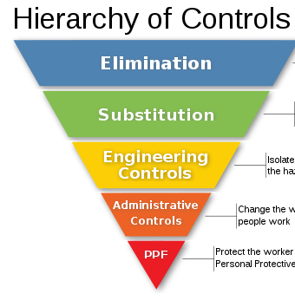
Workplace Controls
Engineering controls
Ex. Utilize air conditioning, fans, increase general ventilation
Work practices
Ex. Modify work schedules for workers who are new to warm environments, require mandatory rest/water breaks, employee rotation, consider scheduling work at a cooler time of day
Personal protective equipment(PPE)
Ex. For hot environments: Insulated suits, reflective clothing, cooling neck wraps, camel packs
Ex. For extremely hot environments: thermally conditioned clothing
Notes:
Implement workplace controls…. if you can make the environment cooler with fans/AC etc and reduce manual workload that would be ideal. You can also modify work practices such as employee rotation, work schedules ( work earlier in the morning before the sun is at full strength), implement mandatory breaks, and additionally provide the correct PPE for hot environments

Slide 17
WATER. REST. SHADE
Water
Employers should provide cool water for workers to drink. Proper hydration is essential to prevent heat-related illness. For those working two hours or more, also provide access to additional fluids that contain electrolytes. Workers should be encouraged to drink at least one cup (8 ounces) of water every 20 minutes while working in the heat not just if they are thirsty.
Rest
When heat stress is high, employers should require workers to take breaks. The length and frequency of rest breaks should increase as heat stress rises. Breaks should last long enough for workers to recover from the heat. Allow the workers to break in a cool area. In hot conditions, skipping breaks is not safe! Employers should make sure that workers rest during all recommended break periods.
Shade
Workers should be given a cool location (whether indoors or outdoors) where they can take their breaks and recover from the heat.
Notes:
Key safety measures for workers
Provide water/ electrolyte drinks..encourage employees to consume water even if they're not thirsty. Have water coolers available
Rest- require breaks..length of time and frequency of breaks should increase as heat stress rises.
Shade-ensure shade if working in an area where its not readily available..canopies, tents, shelters

Slide 18
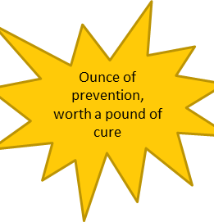
Heat Illness Prevention
Heat-related illnesses can be prevented. Prevention requires employers and workers to recognize heat hazards. Management should commit to:
Take extra precautions to protect new workers.
Train supervisors and workers to control and recognize heat hazards.
Determine, for each worker throughout each workday, whether total heat stress is too high, both from the conditions of that day and recognizing carryover effect possibilities.
Implement engineering and administrative controls to reduce heat stress.
Provide sufficient rest, shade, and fluids.
Notes:
Heat illness can be prevented
Protect new workers by taking extra precautions
Provide training to workers on the recognition of heat hazards and what controls to implement
Monitor the effects of heat stress on the worker and plan accorfdingly
Ensure water, rest and shade
heat illness prevention is applicable to work and personal activities
Remember the OSHA act states that employers are responsible for providing workplaces free of known safety and health hazards.

Slide 19
Employee Rights
Employer shall furnish to each of his employees' employment and a place of employment which are free from recognized hazards that are causing or are likely to cause death or serious physical harm to his employees.
Notes:
Having a heat illness prevention program is vital to protecting employees from illness, injury and even death. Employees have a right to work in a safe and healthy environment free of recognized hazards.

Slide 20
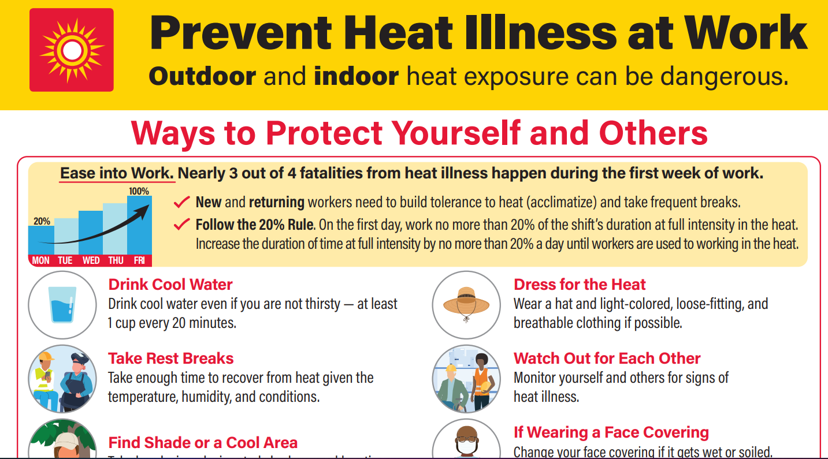
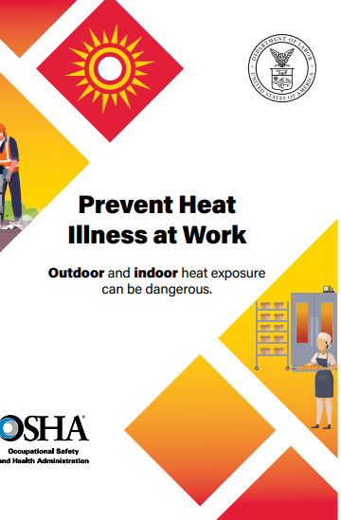
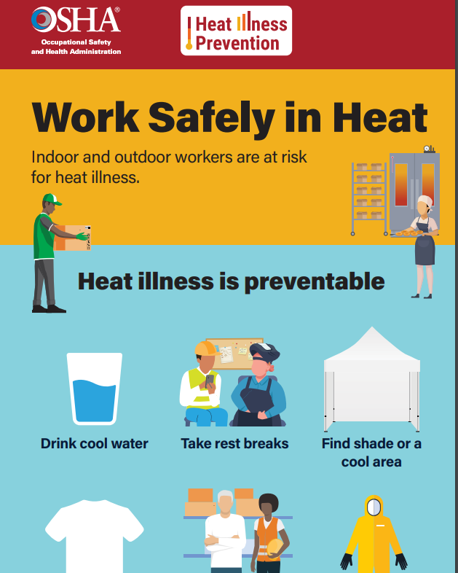
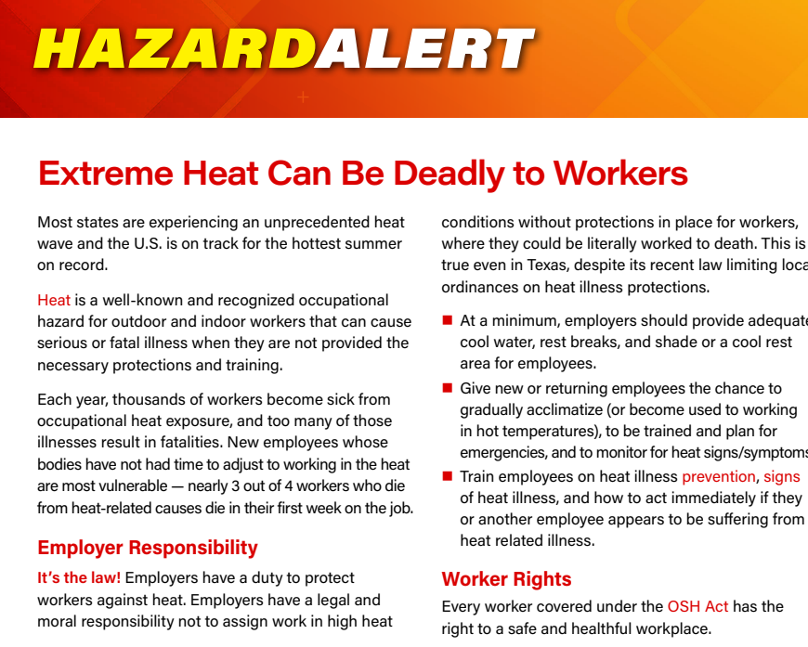

Slide 21
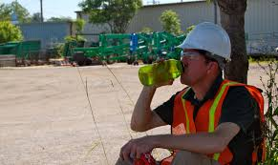
For Additional Information Visit:
OSHA
https://www.osha.gov/heat

Slide 22
VOSH Consultation Services
Onsite visits
Limited/Full
Training
Formal/Informal
Compliance Assistance
Abatement Advice
Best practices/
recommendations
Interpretations
Program Assistance
SHARP

Slide 23
Contact Info
Sarah Smith
757-455-0891 EXT. 432
sarah.smith@doli.virginia.gov

