Slide 1
Update on OSHA’s Small Business Advocacy Review Panel on Heat Injury and Illness Prevention in Outdoor and Indoor Work Settings
OSHA Directorate of Standards and Guidance
August 11, 2023
Small Business Labor Safety Roundtable

Slide 2
Occupational Heat Exposure
Heat is the leading cause of death among all weather-related phenomena in the U.S.
Excessive heat can cause heat stroke and even death if not treated properly
Workers in both outdoor and indoor work settings are at risk

Slide 3
Occupational Heat Injuries, Illnesses, & Fatalities
According to the Bureau of Labor Statistics (BLS):
Exposure to environmental heat resulted in 999 fatalities of U.S. workers from 1992-2021, an average of 33 fatalities per year in that time period
There have been 33,890 estimated work-related heat injuries and illnesses involving days away from work from 2011-2020, an average of 3,389 per year in that time period
Statistics for occupational heat-related illnesses, injuries, and fatalities are likely vast underestimates for several reasons, including:
The varying nature of heat-related symptoms, including their impact on decision-making abilities
The definition of heat-related illnesses often varies by jurisdiction, leading to inconsistent reporting by medical professionals
Datasets heavily rely on self-reported outcomes from employers and employees

Slide 4
Heat Rulemaking Background
On October 27th, 2021, OSHA published an Advance Notice of Proposed Rulemaking (ANPRM) for Heat Injury and Illness Prevention in Outdoor and Indoor Work Settings
The ANPRM announced that OSHA is initiating the rulemaking process to consider a heat-specific workplace standard
A standard specific to heat-related injury and illness prevention would more clearly set forth employer obligations and the measures necessary to effectively protect employees from hazardous heat
OSHA received 965 unique comments, available for viewing at www.regulations.gov (Docket No. OSHA-2021-0009)

Slide 5
Heat Rulemaking Background
On May 3, 2022, OSHA held a virtual public stakeholder meeting on the Agency’s Initiatives to Protect Workers from Heat-Related Hazards
OSHA established a Heat Injury and Illness Prevention Work Group of the National Advisory Committee on Occupational Safety and Health (NACOSH) to help NACOSH provide recommendations on guidance materials and potential elements of a heat injury and illness prevention standard
On May 31, 2023, the Work Group presented its recommendations on potential elements of a proposed heat injury and illness prevention standard for consideration by the full NACOSH committee. After deliberations, NACOSH submitted its recommendations to OSHA.
Recommendations are available at www.regulations.gov (Document No. OSHA-2023-0003-0012)

Slide 6
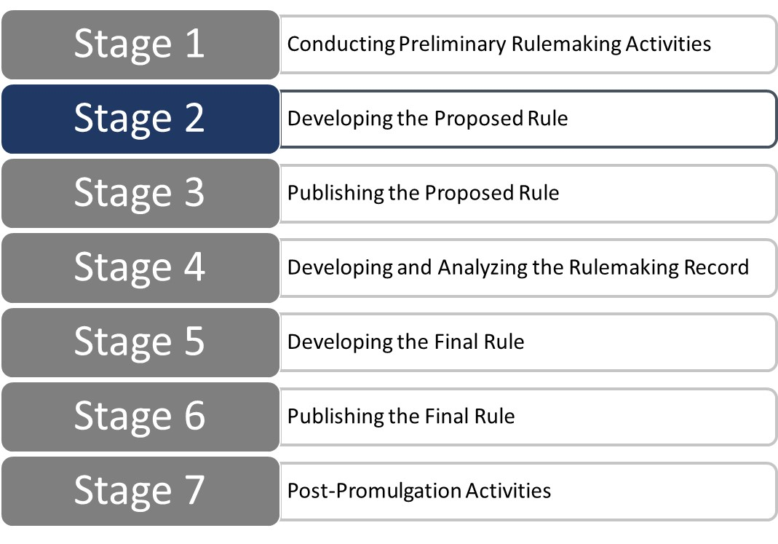
Heat Rulemaking Stages
The next step in the rulemaking process will be to convene a Small Business Advocacy Review (SBAR) Panel, in accordance with the requirements of the Small Business Regulatory Enforcement Fairness Act (SBREFA), to hear comments from small entity representatives on the impacts of a heat-specific standard

Slide 7
SBAR Panel
The SBAR Panel will be comprised of members from the Small Business Administration (SBA) Office of Advocacy, OSHA, and the Office of Management and Budget's Office of Information and Regulatory Affairs (OIRA)
The SBAR Panel will listen to small entity representatives (SERs) who would potentially be affected by the standard and issue a report following the Panel
Each SER will be sent information on potential options OSHA has identified for various elements of a heat-specific standard, and then be asked to participate in a small-group videoconference with the SBAR Panel to discuss any concerns or other input on how these measures might affect the operations of their workplace
OSHA will host several small-group SBAR Panel videoconferences with SERs; these videoconferences will be open for the public to listen to but not participate

Slide 8
Potential Scope
The standard could cover outdoor and indoor work in any/all General Industry, Construction, Maritime, and Agriculture sectors where OSHA has jurisdiction
OSHA is seeking participation from a wide range of sectors and welcomes SERs from any industry that might be affected
Industries that OSHA expects to be most affected by a standard include:
Agriculture, Forestry, and Fishing – Oil and Gas
Building Material and Equipment Suppliers – Postal and Delivery Services
Commercial Kitchens – Recreation and Amusement
Construction – Sanitation and Waste Removal
Drycleaning and Commercial Laundries – Telecommunications
Fire Protection – Temporary Help Services
Landscaping and Facilities Support – Transportation
Maintenance and Repair – Utilities
Manufacturing – Warehousing

Slide 9
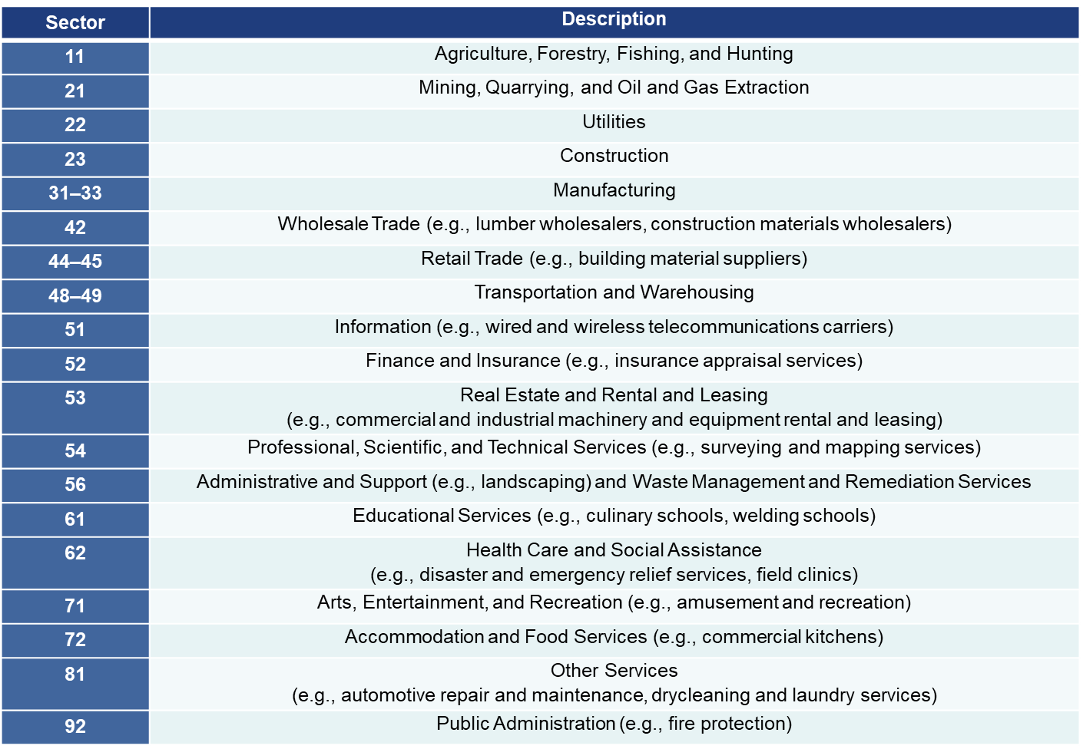
Potential Scope: All Sectors

Slide 10
Materials for SERs
SERs will receive the following materials for review:
Regulatory framework with potential options for various elements of a heat-specific standard
Background document containing a technical summary of the regulatory framework, industry profile, and estimate of unit costs
Open-ended questions to consider
These materials will be made available for public viewing on the OSHA Heat Injury and Illness SBREFA web page (www.osha.gov/heat/sbrefa) and at www.regulations.gov (Docket No. OSHA-2021-0009)

Slide 11
Regulatory Framework Overview
OSHA envisions a programmatic standard that could require employers to create a plan to evaluate and control heat hazards in their workplace
The standard could also include elements that set specifications related to heat exposure levels
The regulatory framework will provide an outline of potential options for various elements of a heat standard, including:
Scope and Application
Heat Injury and Illness Prevention Program
Hazard Identification and Assessment
Hazard Prevention and Control Measures
Medical Treatment and Heat-Related Emergency Response
Worker Training
Recordkeeping

Slide 12
Who Qualifies a SER?
Small businesses
Private entities must meet the SBA definition of a small entity. The size standards vary by industry sector but are usually based on either number of employees or revenue. Check the SBA Table of Size Standards to see if you qualify or contact OSHA or SBA Advocacy for assistance.
Small local government entities
Non-profit entities

Slide 13
How to Participate?
To participate in the SBAR Panel as a SER, please contact Bruce Lundegren from SBA Advocacy, Bruce.Lundegren@sba.gov, (202) 205-6144, or OSHA at OSHAEvents_DSG@dol.gov
To listen in to the SBAR Panel videoconferences but not participate as a SER, the schedule and links will be posted on the OSHA Heat Injury and Illness SBREFA web page, available at www.osha.gov/heat/sbrefa
Updates on the rulemaking process will be provided on OSHA’s heat rulemaking web page, available at www.osha.gov/heat-exposure/rulemaking

Slide 14
Thank you!
schayer.stephen.r@dol.gov

